Slide 1
Implementing an O(n³/log(n)) RNA Folding Algorithm
Sophia Chang, David Dang, David Hsiao

Slide 2
RNA Folding
Nussinov Algorithm
4 Rules
O(n³)
Reordering: Alternative Algorithm
O(n³)
Four-Russians Speedup
Pre-computing & reusing values
O(n³/log(n))
Notes:
Maybe something about how the naive implementation is the nussinov algorithm which is n^3 and is built on 4 cases for folding rna. But by reordering and pre computing values, we can make it n^3/logn

Slide 3
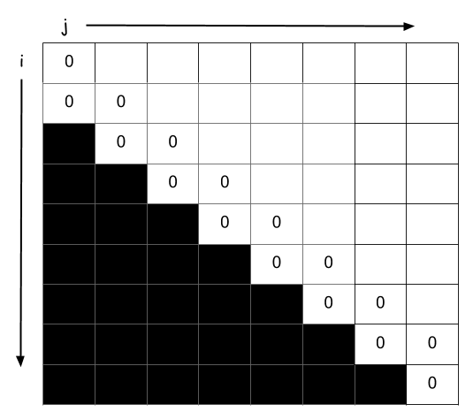
Nussinov Algorithm
Initialization:
S[i,i] = 0; i = {0 to n-1}
S[i, i-1] = 0; i = {1 to n-1}
Recursion:
S[i,j] = max {
S[i+1,j-1] + B(i,j) Rule A
S[i+1,j] Rule B
S[i,j-1] Rule C
max (S[i,k] + S[k+1,j]) where i<k<j Rule D
}
Cost: O(n^3)

Slide 4
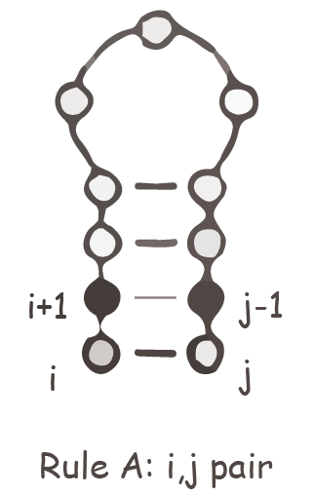
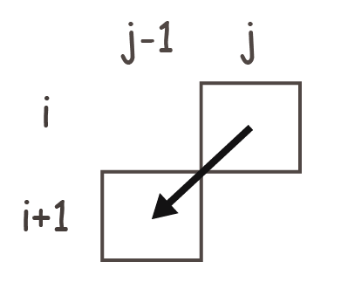
Nussinov: Rule A

Slide 5
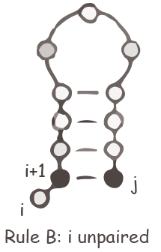
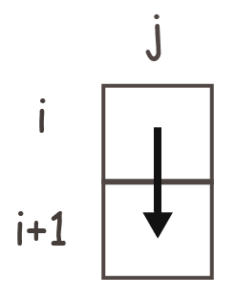
Nussinov: Rule B

Slide 6
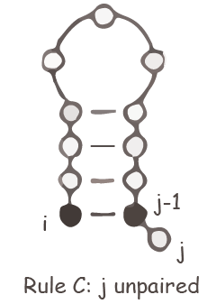
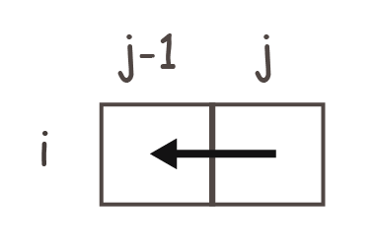
Nussinov: Rule C

Slide 7
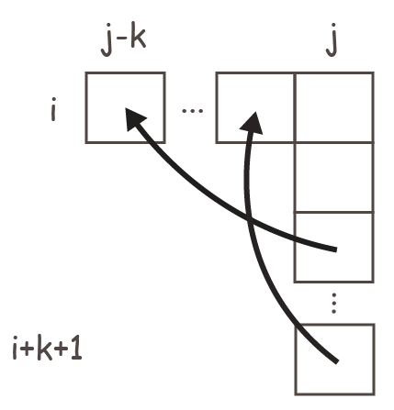
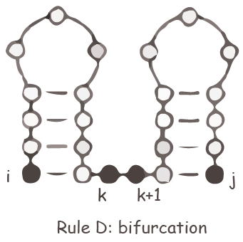
Nussinov: Rule D

Slide 8
Alternative Algorithm
Recursion:
for j = 1 to n:
for i = 0 to j:
S[i,j] = max(S[i+1,j-1] +B[i,j], S[i,j-1]) Rule A and B
for i =j-1 to 0:
S[i,j] = max(S[i+1,j], S[i,j]) Rule C
for k = j-1 to i:
S[i,j] = max(S[i,j], S[i,k-1] + S[k,j]) Rule D
Cost: O(n^3)
Notes:
maybe say something about how this reordering is needed for the 4r algorithm

Slide 9
Speeding Up RNA Folding
Speeding up Rule D will lower the algorithm’s complexity
Splitting the matrix into columns and rows of size q (C group and R group) to form blocks
R table
Binary vectors
Notes:
-- how performance is saved (using r tables, and binary vectors) -- why it works: spliting the matric into block which can be reused to calculate optimal k

Slide 10
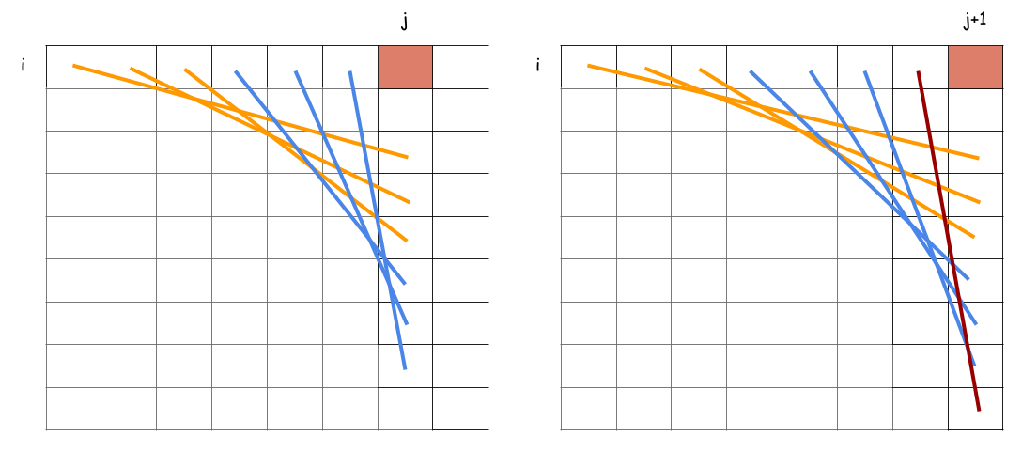

Slide 11
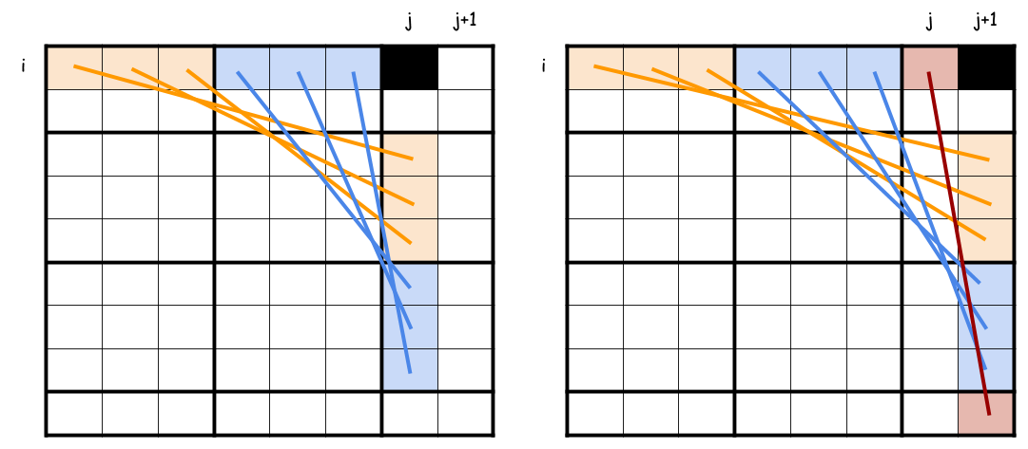

Slide 12
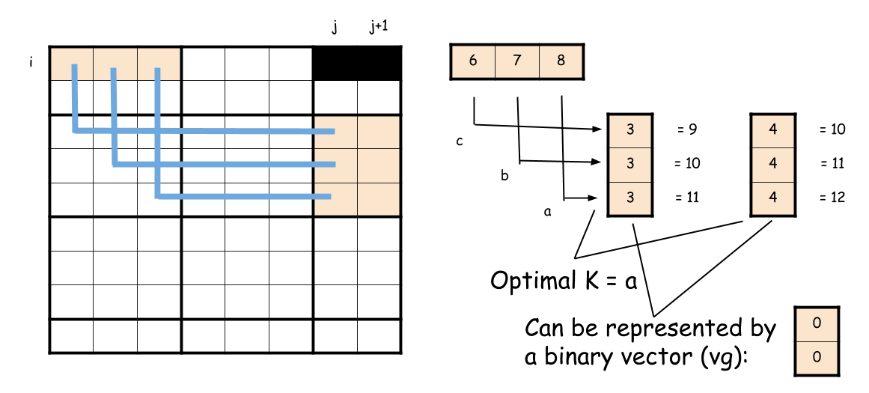

Slide 13
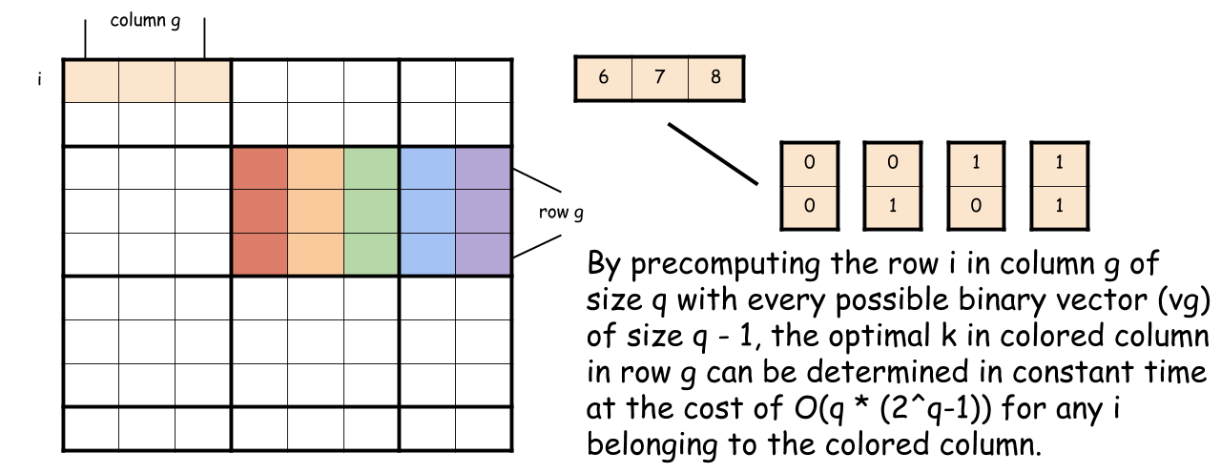

Slide 14
Using the Four-Russians Technique
for j = 1 to n:
for i = 0 to j:
Do Rule A and B
for i = j-1 to 0:
for g = (j-1)/q to i/q:
if i >= g*q: // Is Row i a part of the R Group g
Do Rule C and D
else:
Find optimal k for using the R Table and Binary Vector g
Apply k to Rule D
if (i mod q) == 0: // Is Row i the last row in a R Group
Find the Binary Vector g and save it
if (j+2 mod q) == 0: // Is Column j the last column in a C Group
for all binary vectors possible of size q-1: // There are 2^(q-1) vectors
for i = 0 to j-2
Precompute the R Table for the current C Group by finding
the optimal k given the binary vector

Slide 15
Four-Russians Algorithm
Example
9 X 9 table
q = 3
column j
row i
Notes:
scoring table

Slide 16
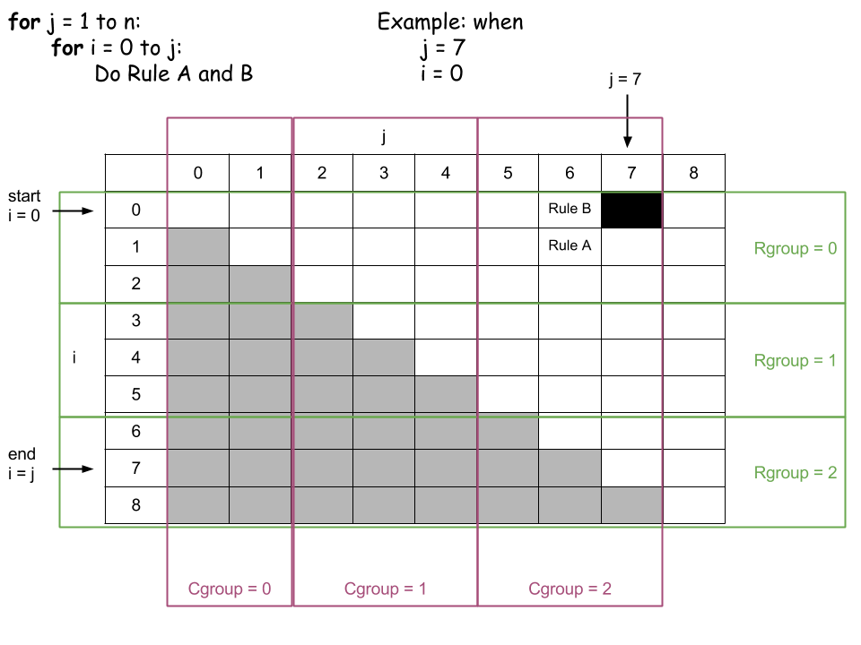
Notes:
one iteration per column
starting j = 1

Slide 17
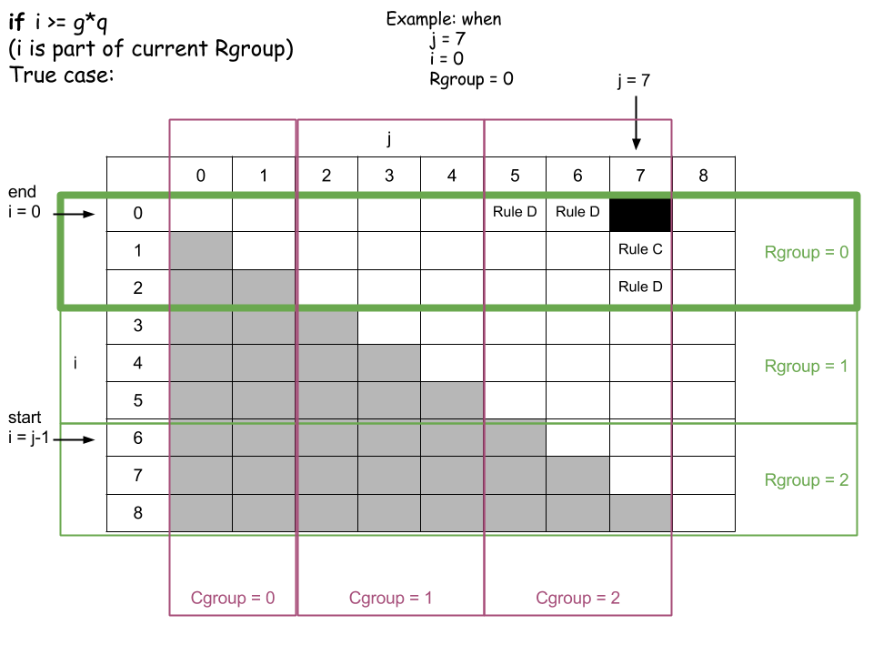

Slide 18
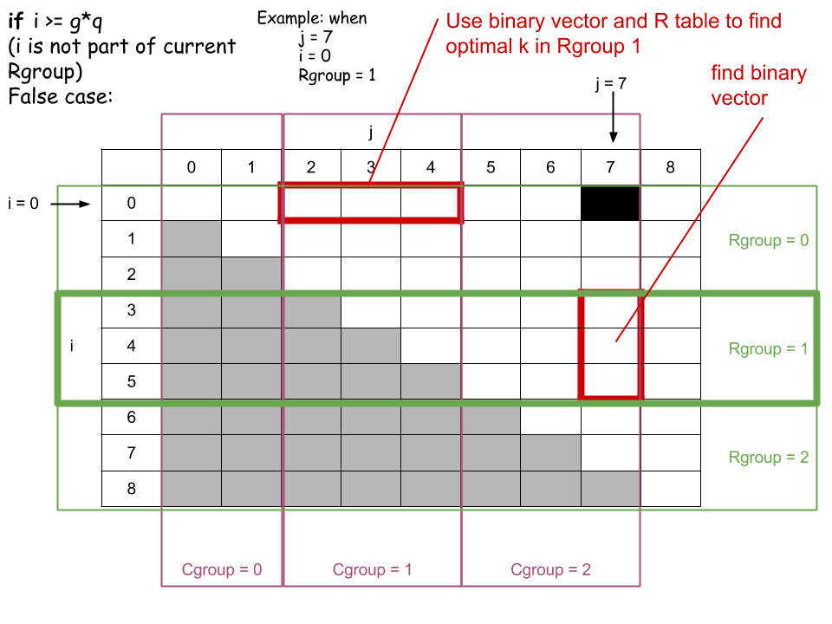
Notes:
purpose: calculate optimal k

Slide 19
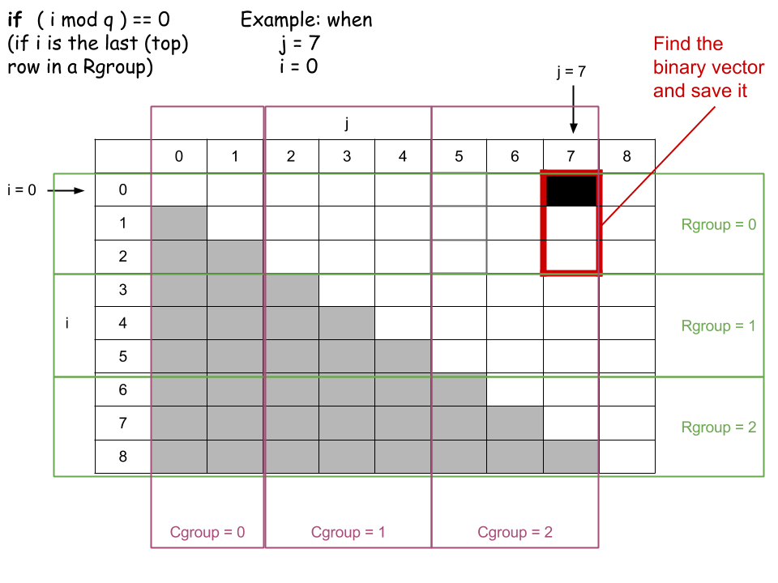

Slide 20
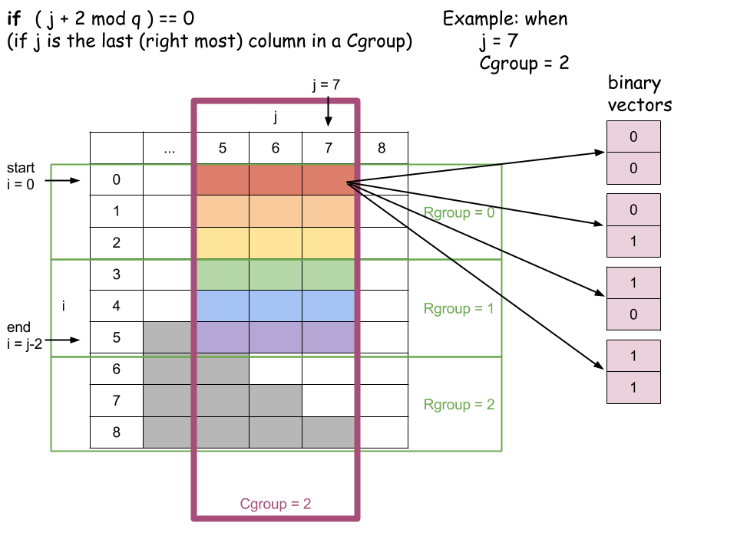

Slide 21
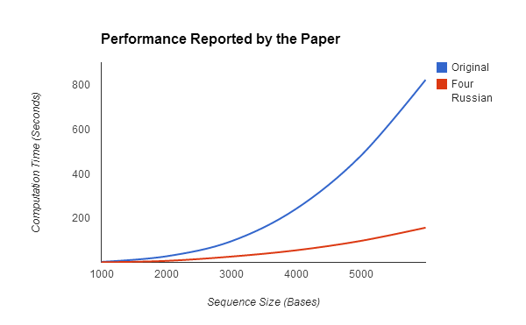
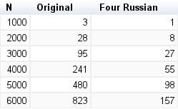
Performance

Slide 22
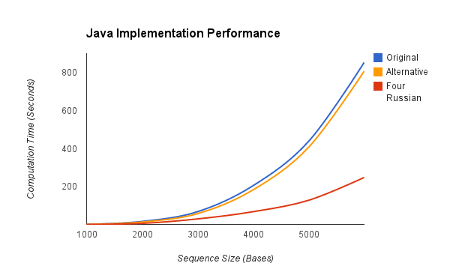
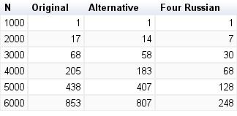
Performance

